Slide 1
Sons of God:
Created in the image and likeness of the Father
Gen 1:26-31
03/12/17
Notes:
To be like Jesus

Slide 2
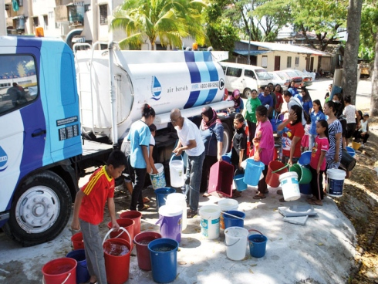

Slide 3
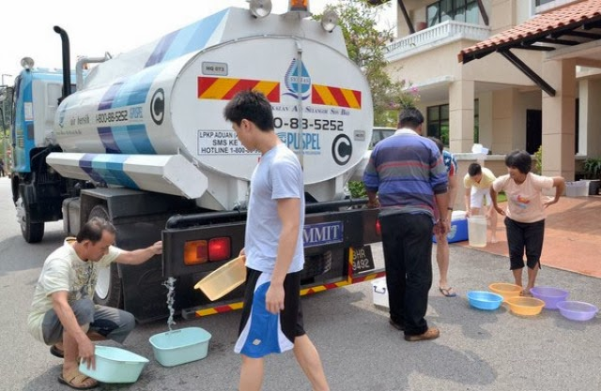

Slide 4
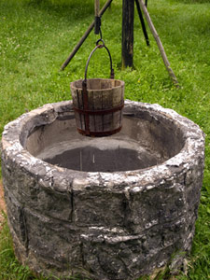
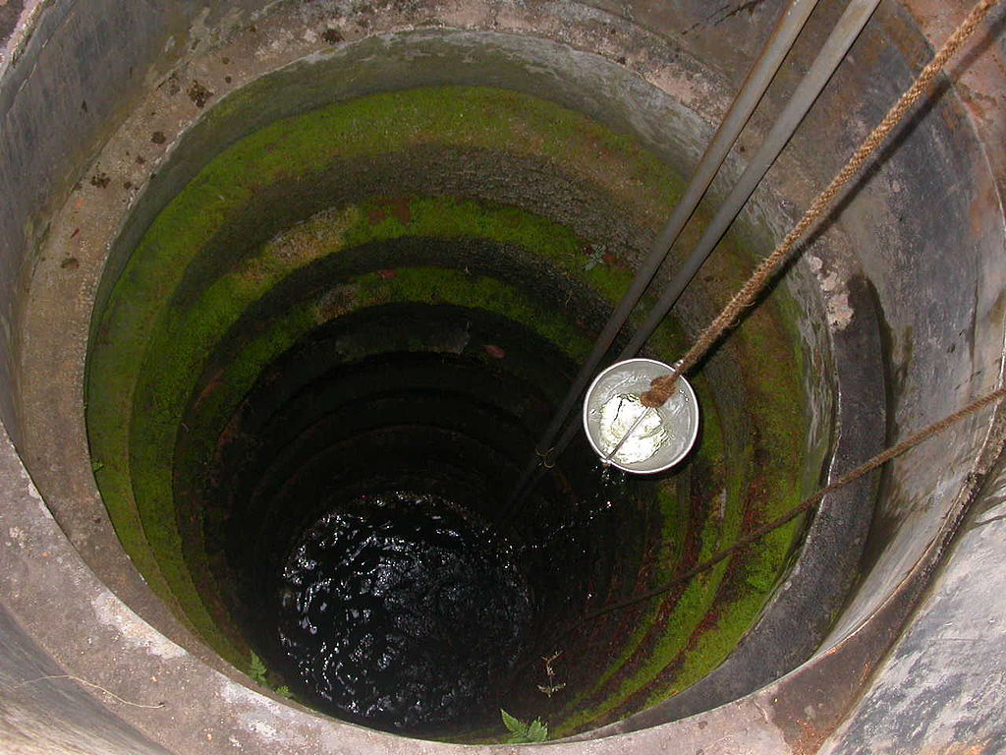

Slide 5
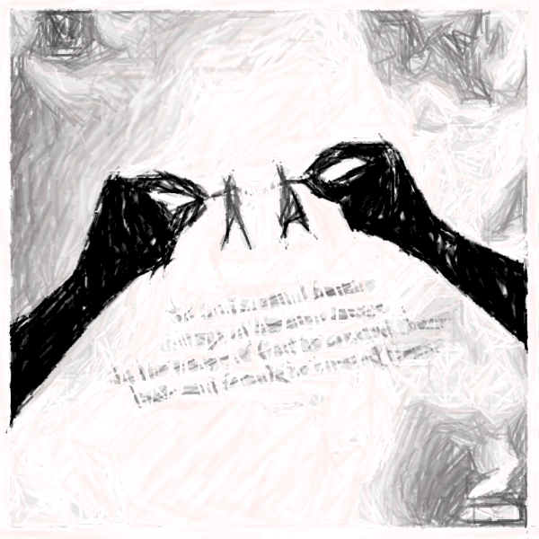
Gen 1:26-31
²⁶ Then God said, “Let Us make man in Our image, according to Our likeness; let them have dominion over the fish of the sea, over the birds of the air, and over the cattle, over all the earth and over every creeping thing that creeps on the earth.” ²⁷ So God created man in His own image; in the image of God He created him; male and female He created them. ²⁸ Then God blessed them, and God said to them, “Be fruitful and multiply; fill the earth and subdue it; have dominion over the fish of the sea, over the birds of the air, and over every living thing that moves on the earth.”

Slide 6
Gen 1:26-31
²⁹ And God said, “See, I have given you every herb that yields seed which is on the face of all the earth, and every tree whose fruit yields seed; to you it shall be for food. ³⁰ Also, to every beast of the earth, to every bird of the air, and to everything that creeps on the earth, in which there is life, I have given every green herb for food”; and it was so. ³¹ Then God saw everything that He had made, and indeed it was very good. So the evening and the morning were the sixth day.

Slide 7
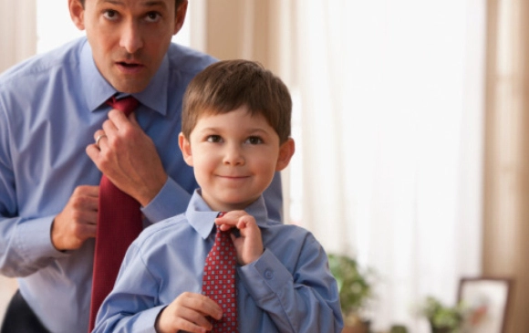
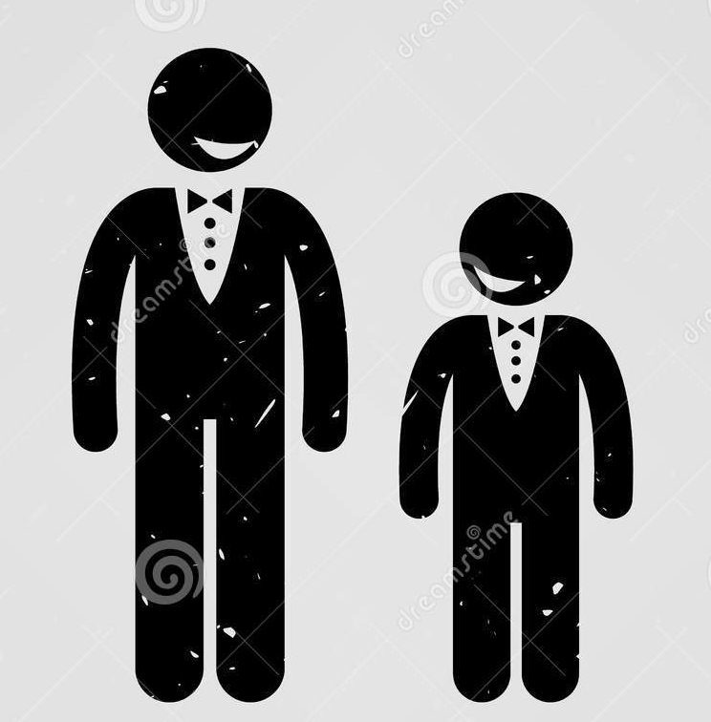
1) Created in His image and likeness
Image = Inward spiritual potential
Likeness = Potential of character, expressing Him
We are to reveal His image, will & nature.

Slide 8
2 Cor 3:17-18
¹⁷ Now the Lord is the Spirit; and where the Spirit of the Lord is, there is liberty.
¹⁸ But we all, with unveiled face, beholding as in a mirror the glory of the Lord, are being transformed into the same image from glory to glory, just as by the Spirit of the Lord.

Slide 9
Rom 8:28-30
²⁸ And we know that all things work together for good to those who love God, to those who are the called according to His purpose.
²⁹ For whom He foreknew, He also predestined to be conformed to the image of His Son, that He might be the firstborn among many brethren. ³⁰ Moreover whom He predestined, these He also called; whom He called, these He also justified; and whom He justified, these He also glorified.

Slide 10
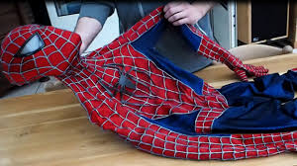
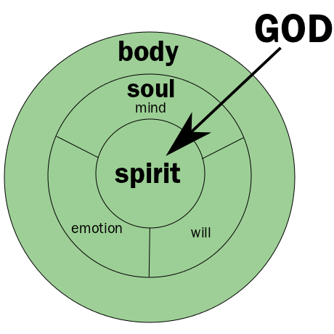
2) Created as a spirit being with a soul and body
We are the same kind as God (spirit)
Jn 4:24 - God is Spirit, and those who worship Him must worship in spirit and truth.”

Slide 11
2) Created as a spirit being with a soul and body
Because we are in spirit dimension, we can communicate with Him.
Life is in the spirit but our soul determines the Life that will come forth
- we have a choice!
- power to choose what is right.
1 Pet 4: ¹Therefore, since Christ suffered for us in the flesh, arm yourselves also with the same mind, for he who has suffered in the flesh has ceased from sin, ² that he no longer should live the rest of his time in the flesh for the lusts of men, but for the will of God.

Slide 12
3) Created to have a relationship with God
Gen 3:⁸ And they heard the sound of the Lord God walking in the garden in the cool of the day, and Adam and his wife hid themselves from the presence of the Lord God among the trees of the garden.
⁹ Then the Lord God called to Adam and said to him, “Where are you?”

Slide 13
3) Created to have a relationship with God
God came looking for man.
Rom 5:8 – “But God demonstrates His own love toward us, in that while we were still sinners, Christ died for us.”
Sin separates us but does not scared Him. He removes sin and is faithful to forgive. Acknowledge and repent.
“He will save His people from their sins”

Slide 14
Conclusion (men vs angels)
We were created to be children of God (family). Jesus restore the relationship.
- Angels were created to assist (minister) us Heb 1:14
We were created to rule not angels. Jesus came to show us how, an example.
Heb 2:5-11
Man through Christ can only be better and better, angels were already created perfect, so no more redemption for them.

